Slide 1

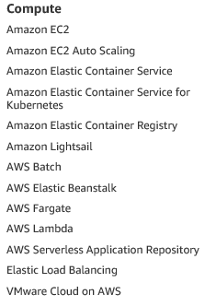
Compute
Notes:
Demo:
#!/bin/bash
yum install -y httpd
echo "<html><body><h1>Welcome! </br> VPTrips </h1></body></html>" > /var/www/html/index.html
service httpd start

Slide 2

EC2
Amazon Elastic Compute Cloud (Amazon EC2)
Notes:
Demo:
#!/bin/bash
yum install -y httpd
echo "<html><body><h1>Welcome! </br> VPTrips </h1></body></html>" > /var/www/html/index.html
service httpd start

Slide 3

AWS Pricing models
On-Demand instances > without any up-front payment or long-term commitment
Spot instances > flexible start and end times
Reserved Instances > 75% cost saving
Dedicated Host is a physical EC2 server dedicated for your use, with on-demand or Reserved.
Pay-as-you-go model
Use more pay less

Slide 4
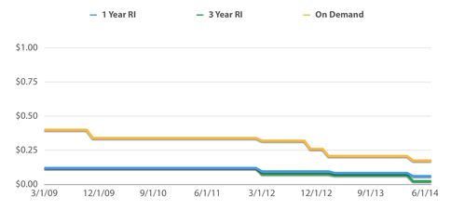
AWS Pricing models

Slide 5

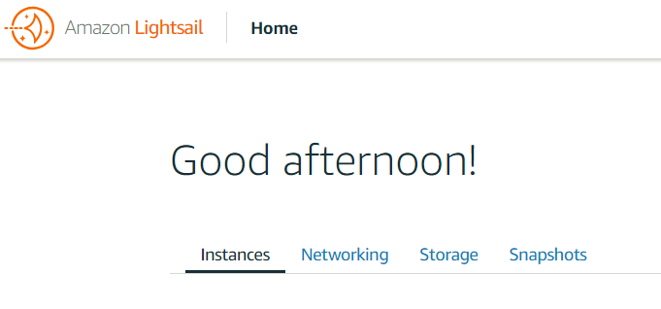
Amazon LightSail

Slide 6

ECS
Amazon Elastic Container Service (ECS)
Notes:
Amazon ECS makes it easy to deploy, manage, and scale Docker containers running applications, services, and batch processes. Amazon ECS places containers across your cluster based on your resource needs and is integrated with familiar features like Elastic Load Balancing, EC2 security groups, EBS volumes and IAM roles.

Slide 7

Lambda
AWS Lambda
lets you run code without thinking about servers.
Notes:
You pay only for the compute time you consume — there is no charge when your code is not running. With Lambda, you can run code for virtually any type of application or backend service, all with zero administration.

Slide 8
AWS Batch
AWS Batch
Notes:
AWS Batch enables you to easily and efficiently run batch computing workloads of any scale on AWS using Amazon EC2 and Amazon EC2 Spot.

Slide 9

AWS Elastic Beanstalk
AWS Elastic Beanstalk
Notes:
With Elastic Beanstalk, you can deploy, monitor, and scale an application quickly and easily. Let us do the heavy lifting so you can focus on your business.
To deploy your existing web application, create an application source bundle and then create a new application. If you're using Git and would prefer to use it with our command line tool, please see Getting Started with the EB CLI.
To deploy a sample application with just one click, select a platform and click Launch Now.
By launching the sample application, you allow AWS Elastic Beanstalk to administer AWS resources and necessary permissions on your behalf. Learn more

Slide 10
EC2 Demo
#!/bin/bash
yum install -y httpd
echo "<html><body><h1>Welcome! </br> Design & Developed by Kumar</h1></body></html>" > /var/www/html/index.html
service httpd start
chkconfig httpd on
Notes:
EC2 with console

Slide 11
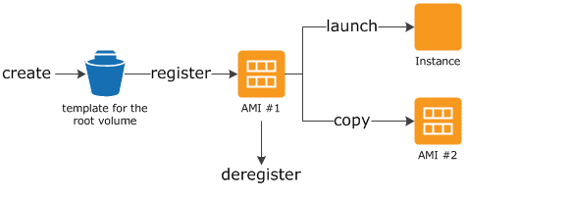
Amazon Machine Images (AMI)
Notes:
Amazon Linux AMIs
The Amazon Linux AMI is a supported and maintained Linux image provided by AWS. The following are some of the features of Amazon Linux:
A stable, secure, and high-performance execution environment for applications running on Amazon EC2.
Provided at no additional charge to Amazon EC2 users.
Repository access to multiple versions of MySQL, PostgreSQL, Python, Ruby, Tomcat, and many more common packages.
Updated on a regular basis to include the latest components, and these updates are also made available in the yum repositories for installation on running instances.
Includes packages that enable easy integration with AWS services, such as the AWS CLI, Amazon EC2 API and AMI tools, the Boto library for Python, and the Elastic Load Balancing tools.

Slide 12
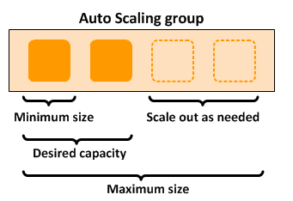
What Is Amazon EC2 Auto Scaling?
Notes:
Amazon EC2 Auto Scaling helps you ensure that you have the correct number of Amazon EC2 instances available to handle the load for your application. You create collections of EC2 instances, called Auto Scaling groups. You can specify the minimum number of instances in each Auto Scaling group, and Auto Scaling ensures that your group never goes below this size. You can specify the maximum number of instances in each Auto Scaling group, and Auto Scaling ensures that your group never goes above this size. If you specify the desired capacity, either when you create the group or at any time thereafter, Auto Scaling ensures that your group has this many instances. If you specify scaling policies, then Auto Scaling can launch or terminate instances as demand on your application increases or decreases.
For example, the following Auto Scaling group has a minimum size of 1 instance, a desired capacity of 2 instances, and a maximum size of 4 instances. The scaling policies that you define adjust the number of instances, within your minimum and maximum number of instances, based on the criteria that you specify.

Slide 13
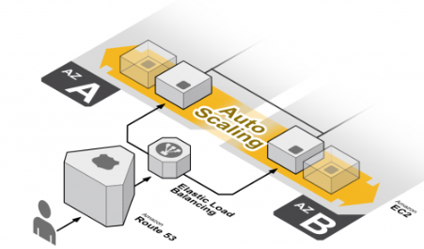
EC2 Auto Scaling

Slide 14
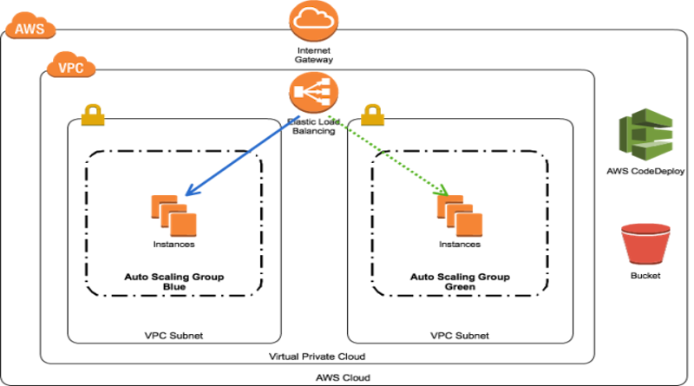
Elastic Load Balancing
Notes:
Achieve fault tolerance for any application by ensuring scalability, performance, and security.

Slide 15
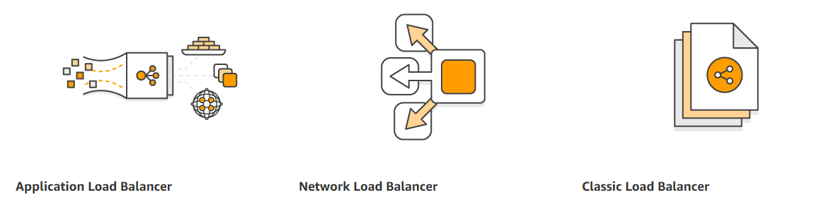
Elastic Load Balancing
Notes:
Layer 4 through Layer 7 are services delivered by the upper layers of the Open Systems Interconnection (OSI) communication model. Layer 4-7 services, sometimes referred to as the upper layers, support end-to-end communication between a source and destination application and are used whenever a message passes from or to a user.
Layer 4, the Transport Layer, ensures end-to-end delivery of messages for both "connection-mode" data such as TCP connections and "connectionless-mode" data such as UDP datagrams. For both modes, the endpoints of communication are identified by port numbers such as TCP port 80 or UDP port 161.
Layer 5, the Session Layer, provides services for coordinating communication between applications and synchronizing message delivery. For example, a protocol with suspend/resume or checkpoint/rollback capabilities includes session layerservices such as ITU X.225, AppleTalk or RPC.
Layer 6, the Presentation Layer, provides services for converting data from local format (abstract syntax) into a machine-independent format (transfer syntax). Many application protocols are defined in Abstract Syntax Notation One (ASN.1) notation. ASN.1 defines a set of data structures mapped to encoding rules – for example, how an Integer should be encoded into a bit string to be transmitted to and decoded by a recipient using XML Encoding Rules (XER).
Layer 7, the Application Layer provides common services used by applications to establish, release and abort communication with each other, as well as specific services. Most applications “live” at Layer 7, including the File Transfer Protocol (FTP), the Simple Mail Transfer Protocol (SMTP), the Post Office Protocol (POP), the Hyper Text Transfer Protocol (HTTP) and the Domain Name System Protocol (DNS).

Slide 16
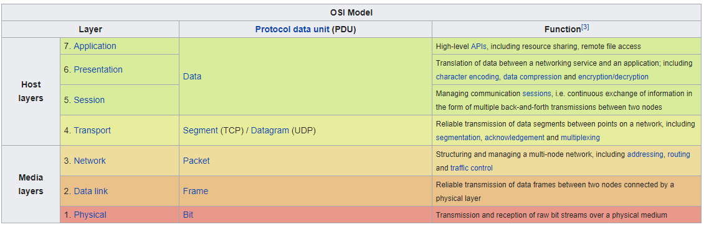
Elastic Load Balancing
https://en.wikipedia.org/wiki/OSI_model

Slide 17
Q&A
?????
Notes:
#!/bin/bash
yum install -y httpd
echo "<html><body><h1>Welcome! </br> Design & Developed by Kumar</h1></body></html>" > /var/www/html/index.html
service httpd start

